Slide 1

Programming on Python
Lecture 2
Conditional Statements. Looping and Control Statements. Python Lists.
Complied by
Aizhan Altaibek

Slide 2
Python Lists

Slide 3

Python Data Types
●
float - real numbers int - integer numbers str - string, text bool - True, False
●
●
●
In [1]: height = 1.73 In [2]: tall = True
●
Each variable represents single value

Slide 4

Problem
●
Data Science: many data points Height of entire family
●
In | [3]: | height1 | = | 1.73
In | [4]: | height2 | = | 1.68
In | [5]: | height3 | = | 1.71
In | [6]: | height4 | = | 1.89
●
Inconvenient

Slide 5
Python List
Intro to Python for Data Science
[a, b, c]
In [7]:
[1.73, 1.68, 1.71, 1.89]
[1.73, 1.68, 1.71, 1.89]
Out[7]:
In [8]: fam = [1.73, 1.68, 1.71, 1.89]
In [9]:
fam
[1.73, 1.68, 1.71, 1.89]
Out[9]:
●
Name a collection of values Contain any type
Contain diﬀerent types
●
●

Slide 6

Python List
[a, b, c]
In [10]: fam = ["liz", 1.73, "emma", 1.68, "mom", 1.71, "dad", 1.89]
In [11]:
fam
['liz', 1.73, 'emma', 1.68, 'mom', 1.71, 'dad', 1.89]
Out[11]:
["liz", 1.73]
["emma", 1.68]
["mom", 1.71]
["dad", 1.89]

Slide 7
Python List
[a, b, c]
In [10]:
fam =
["liz",
1.73,
"emma",
1.68,
"mom",
1.71,
"dad",
1.89]
In [11]:
Out[11]:
fam ['liz',
1.73,
'emma',
1.68,
'mom',
1.71,
'dad',
1.89]
In [11]:
fam2
= [["liz",
1.73],
["emma",
["mom",
["dad",
1.68],
1.71],
1.89]]
In [12]: | fam2
Out[12]: | [['liz', | 1.73], | ['emma', | 1.68],
['mom',
1.71],
['dad',
1.89]]

Slide 8

List type
In [13]:
type(fam) list
Out[13]:
In [14]:
type(fam2) list
Out[14]:
●
Specific functionality Specific behavior
●

Slide 9
Subsetting Lists

Slide 10

Subsetting lists
Intro to Python for Data Science
In [1]:
fam = ["liz",
1.73,
"emma",
1.68,
"mom",
1.71,
"dad",
1.89]
In [ Out
2]: fam
[2]: ['liz', 1.73, 'emma', 1.68, 'mom', 1.71, 'dad', 1.89]
index: 0 | 1 | 2 | 3 | 4 | 5 | 6 | 7
"zero-based indexing"

Slide 11
Subsetting lists
In [1]:
fam = ["liz",
1.73,
"emma",
1.68,
"mom",
1.71,
"dad",
1.89]
In [ Out
2]: fam
[2]: ['liz', 1.73, 'emma', |  |  |  | 'mom', | 1.71, | 'dad', | 1.89]
index: 0 | 1 | 2 | 3 | 4 | 5 | 6 | 7
1.68,
In [3]:
Out[3]:
fam[3] 1.68

Slide 12
Subsetting lists
In [1]:
fam = ["liz",
1.73,
"emma",
1.68,
"mom",
1.71,
"dad",
1.89]
In [ Out
2]: fam
[2]: ['liz', 1.73, 'emma', 1.68, 'mom', 1.71, |  |  |  |  |  | , | 1.89]
index: 0 | 1 | 2 | 3 | 4 | 5 |  | 7
'dad'
6
In [3]:
Out[3]:
In [4]:
Out[4]:
fam[3] 1.68
fam[6]
'dad'

Slide 13
Subsetting lists
In [1]:
fam = ["liz",
1.73,
"emma",
1.68,
"mom",
1.71,
"dad",
1.89]
In [ Out
2]: fam
[2]: ['liz', 1.73, 'emma', 1.68, 'mom', 1.71, 'dad',
index: 0 | 1 | 2 | 3 | 4 | 5 | 6 | 7
-8 | -7 | -6 | -5 | -4 | -3 | -2 | -1
1.89]
In [3]:
Out[3]:
In [4]:
Out[4]:
In [5]:
Out[5]:
fam[3] 1.68
fam[6]
'dad'
fam[-1] 1.89

Slide 14
Subsetting lists
In [1]:
fam =
["liz",
1.73,
"emma",
1.68,
"mom",
1.71,
"dad",
1.89]
In [2]:
Out[2]:
fam ['liz',
1.73, 'emma', 1.68, 'mom', 1.71,
1 2 3 4 5
-7 -6 -5 -4 -3
'dad'
6
-2
, 1.89]
7
-1
index: 0
-8
In [3]:
Out[3]:
In [4]:
Out[4]:
In [5]:
Out[5]:
In [6]:
Out[6]:
fam[3] 1.68
fam[6]
'dad'
fam[-1] 1.89
fam[-2] 'dad'

Slide 15

List slicing
In [7]: fam
Out[7]: | ['liz', | 1.73, | 'emma', |  |  |  | 'dad', | 1.89]
 | 0 | 1 | 2 | 3 | 4 | 5 | 6 | 7
1.68, 'mom', 1.71,
In [8]:
Out[8]:
fam[3:5] [1.68, 'mom']
[ start : end ]
inclusive exclusive

Slide 16
List slicing
In [7]: fam
Out[7]: | ['liz', |  |  |  | 'mom', | 1.71, | 'dad', | 1.89]
 | 0 | 1 | 2 | 3 | 4 | 5 | 6 | 7
1.73, 'emma', 1.68,
In [8]:
Out[8]:
In [9]:
Out[9]:
fam[3:5] [1.68, 'mom']
fam[1:4] [1.73, 'emma',
1.68]
[ start : end ]
inclusive exclusive

Slide 17

List slicing
In [7]: fam
Out[7]:
['liz', 1.73, 'emma', 1.68,
0 1 2 3
'mom', 1.71, 'dad', 1.89]
4 5 6 7
In [8]:
Out[8]:
fam[3:5] [1.68, 'mom']
In [9]: | fam[1:4]
Out[9]: | [1.73, 'emma', | 1.68]
In [10]: | fam[:4]
Out[10]: | ['liz', | 1.73, | 'emma', | 1.68]

Slide 18
List slicing
In [7]: fam
Out[7]: | ['liz', | 1.73, | 'emma', | 1.68, | 'mom',
 | 0 | 1 | 2 | 3 | 4 | 5 | 6 | 7
1.71, 'dad', 1.89]
In [8]:
Out[8]:
fam[3:5] [1.68, 'mom']
In [9]: | fam[1:4]
Out[9]: | [1.73, 'emma', | 1.68]
In [10]:
Out[10]:
In [11]:
Out[11]:
fam[:4]
['liz',
1.73,
'emma',
1.68]
fam[5:] [1.71, 'dad',
1.89]

Slide 19
Manipulating Lists

Slide 20
List Manipulation
●
Change list elements Add list elements Remove list elements
●
●

Slide 21

Changing list elements
In [1]:
fam =
["liz",
1.73,
"emma",
1.68,
"mom",
1.71,
"dad",
1.89]
In [2]:
Out[2]:
In [3]:
In [4]:
Out[4]:
fam ['liz',
1.73,
'emma',
1.68,
'mom',
1.71,
'dad',
1.89]
fam[7] =
fam
1.86
['liz', 1.73,
'emma',
1.68,
'mom',
1.71,
'dad',
1.86]
In | [5]: | fam[0:2] | = | ["lisa", | 1.74]
In | [6]: | fam
Out[6]:
['lisa',
1.74,
'emma',
1.68,
'mom',
1.71,
'dad',
1.86]

Slide 22

Adding and removing elements
In [7]: fam + ["me", 1.79]
Out[7]: ['lisa', 1.74,'emma', 1.68,
'mom', 1.71, 'dad', 1.86, 'me', 1.79]
In [8]: fam_ext = fam + ["me", 1.79]
In [9]: del(fam[2])
In [10]:
fam
['lisa', 1.74, 1.68, 'mom', 1.71, 'dad', 1.86]
Out[10]:
In [11]: del(fam[2])
In [12]:
fam
['lisa', 1.74, 'mom', 1.71, 'dad', 1.86]
Out[12]:

Slide 23

Behind the scenes (1)
In [13]:
x = ["a",
"b",
"c"]
In [14]: y = x
x
"a"
"b"
"c"

Slide 24
Behind the scenes (1)
In [13]:
x = ["a",
"b",
"c"]
y
In [14]: y = x
x
In [15]:
y[1]
= "z"
"a"
"b"
"c"
In [16]: | y
Out[16]: | ['a', | 'z', | 'c']
In [17]: x Out[17]: ['a',
'z',
'c']

Slide 25
Behind the scenes (2)
In [18]:
x = ["a", "b",
y = list(x)
"c"]
x
y
In [19]:
"a"
"b"
"c"
"a"
"b"
"c"
In [20]:
y = x[:]
In [21]:
y[1]
= "z"

Slide 26
Behind the scenes (2)
In [18]:
x = ["a", "b",
y = list(x)
"c"]
x
y
In [19]:
"a"
"b"
"c"
"a"
"z"
"c"
In [20]:
y = x[:]
In [21]:
y[1] = "z"
In [22]: x Out[22]: ['a',
'b',
'c']

Slide 27
Comparison operators

Slide 28
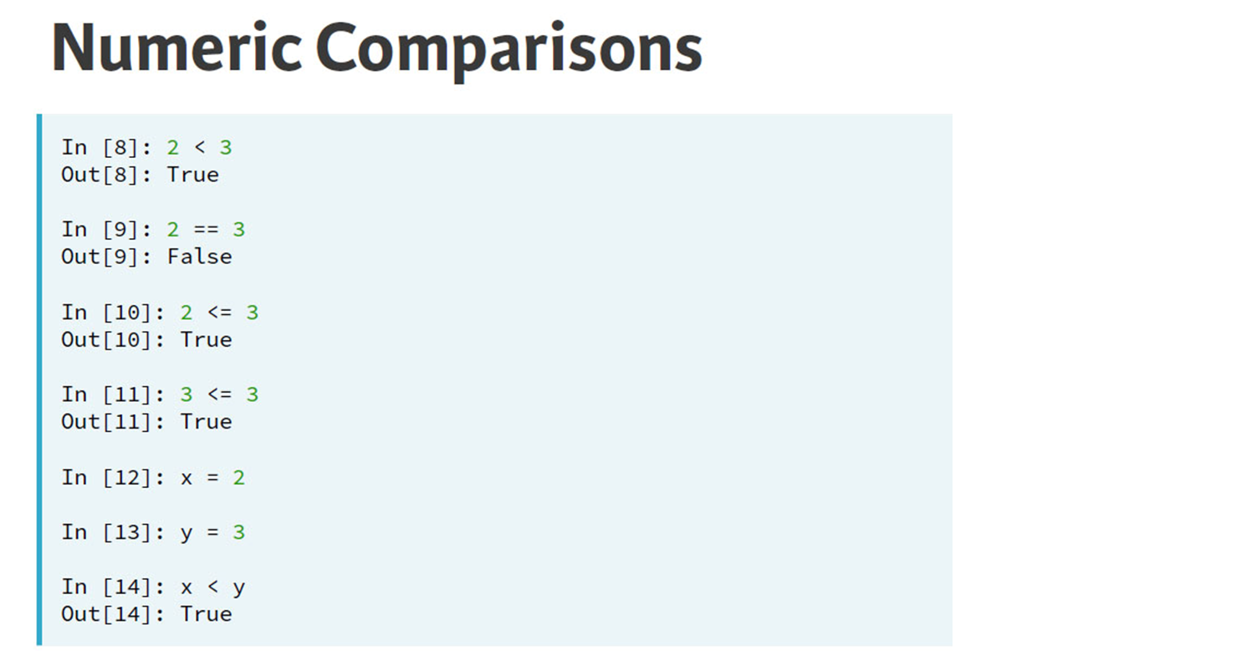

Slide 29
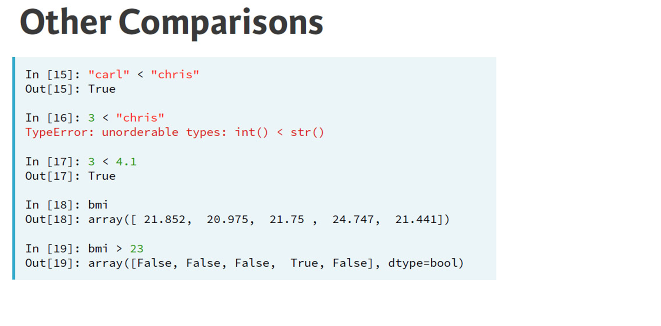

Slide 30
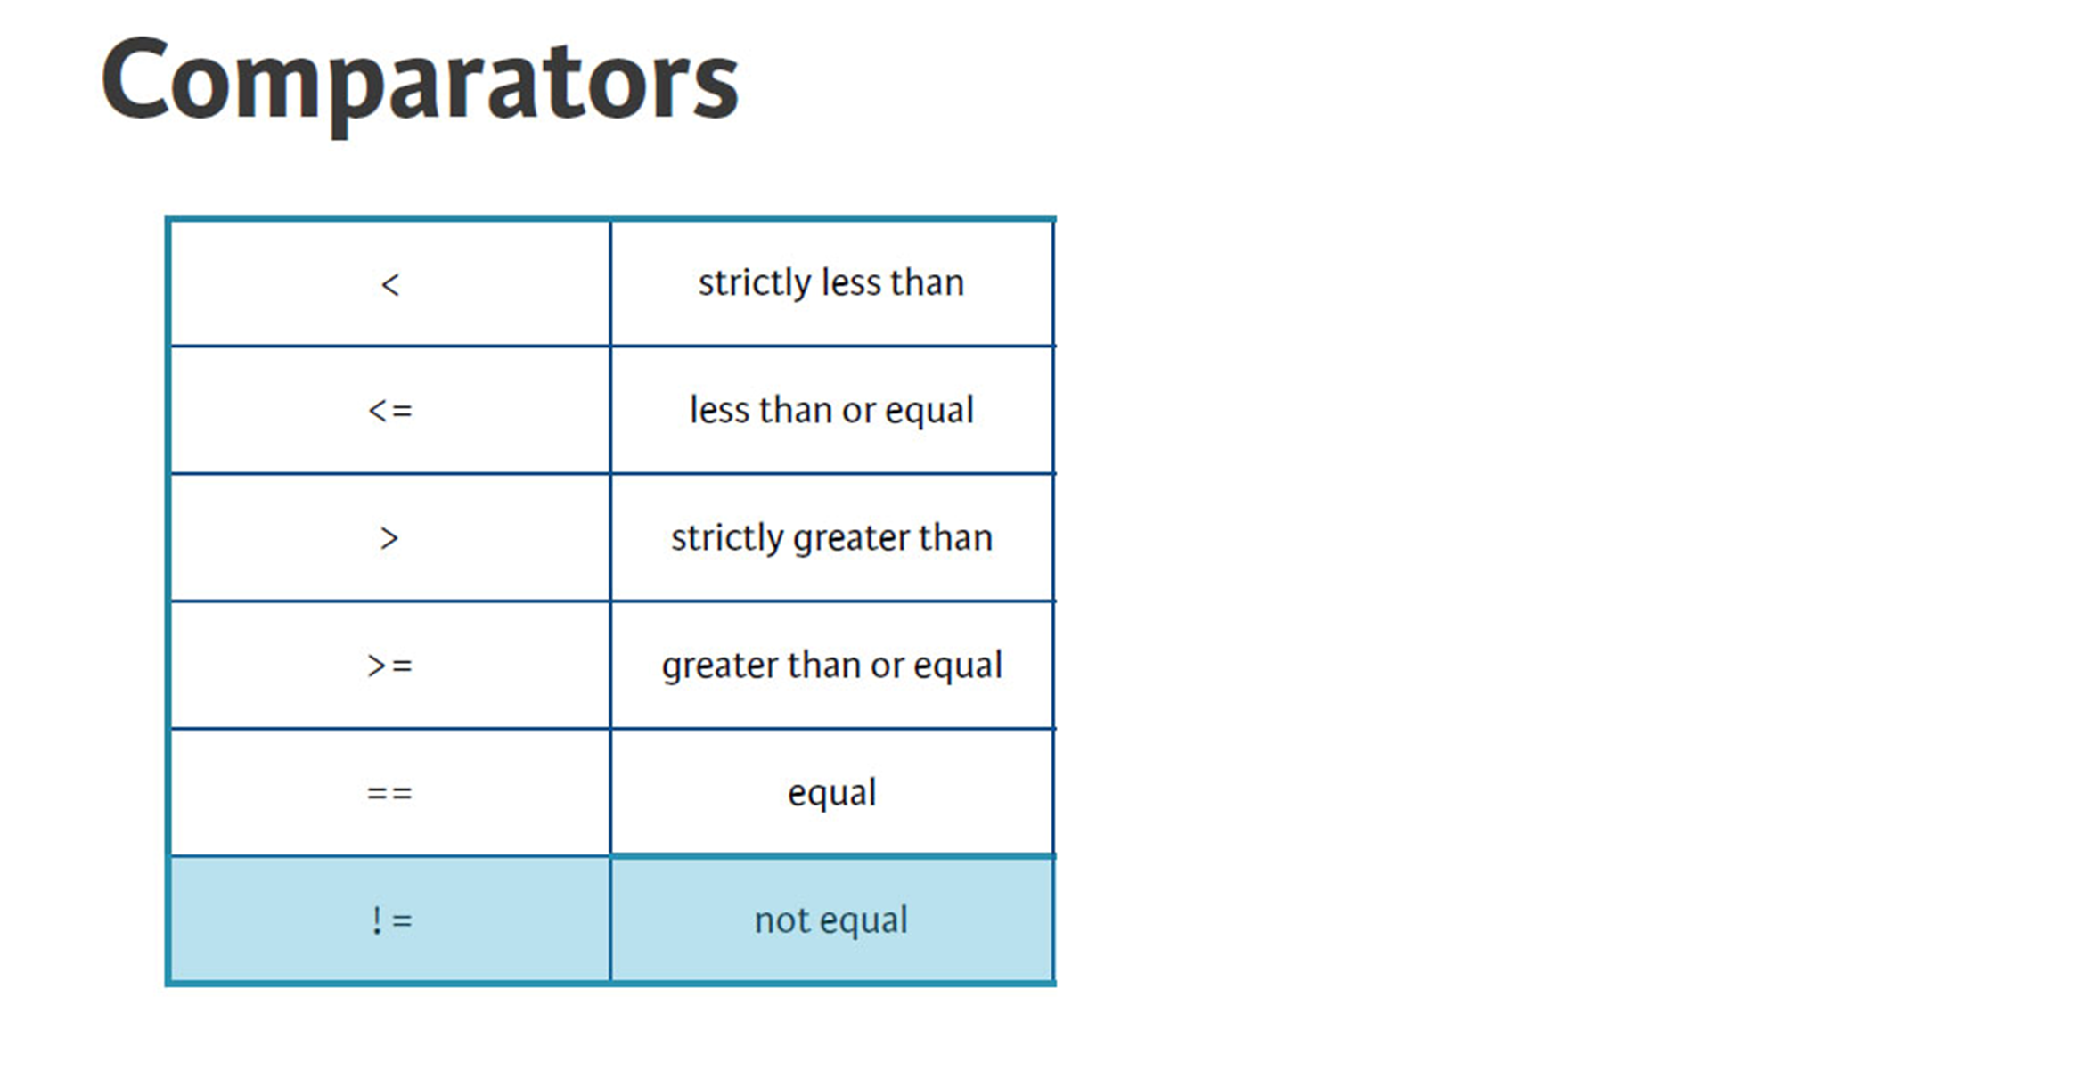

Slide 31


Slide 32
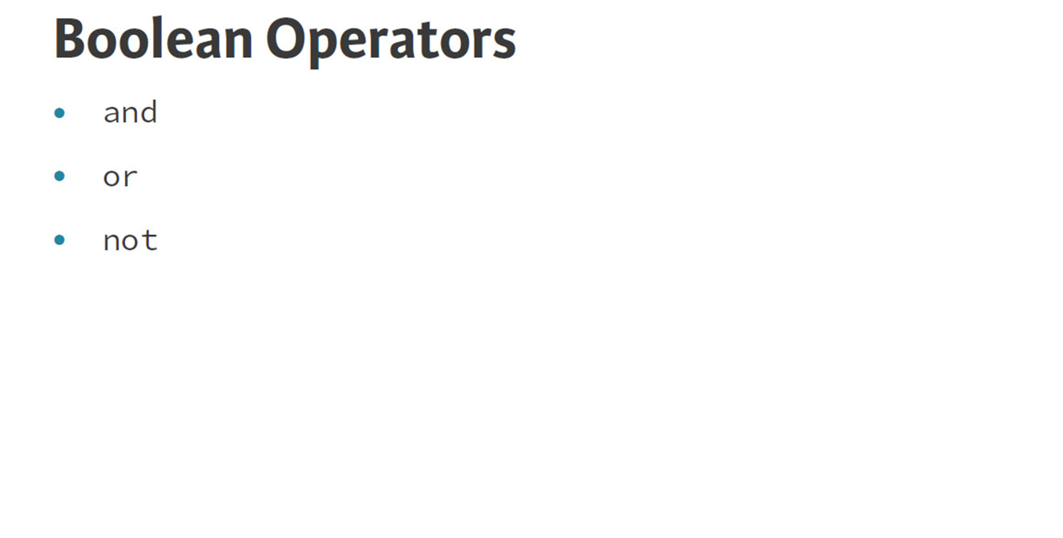

Slide 33
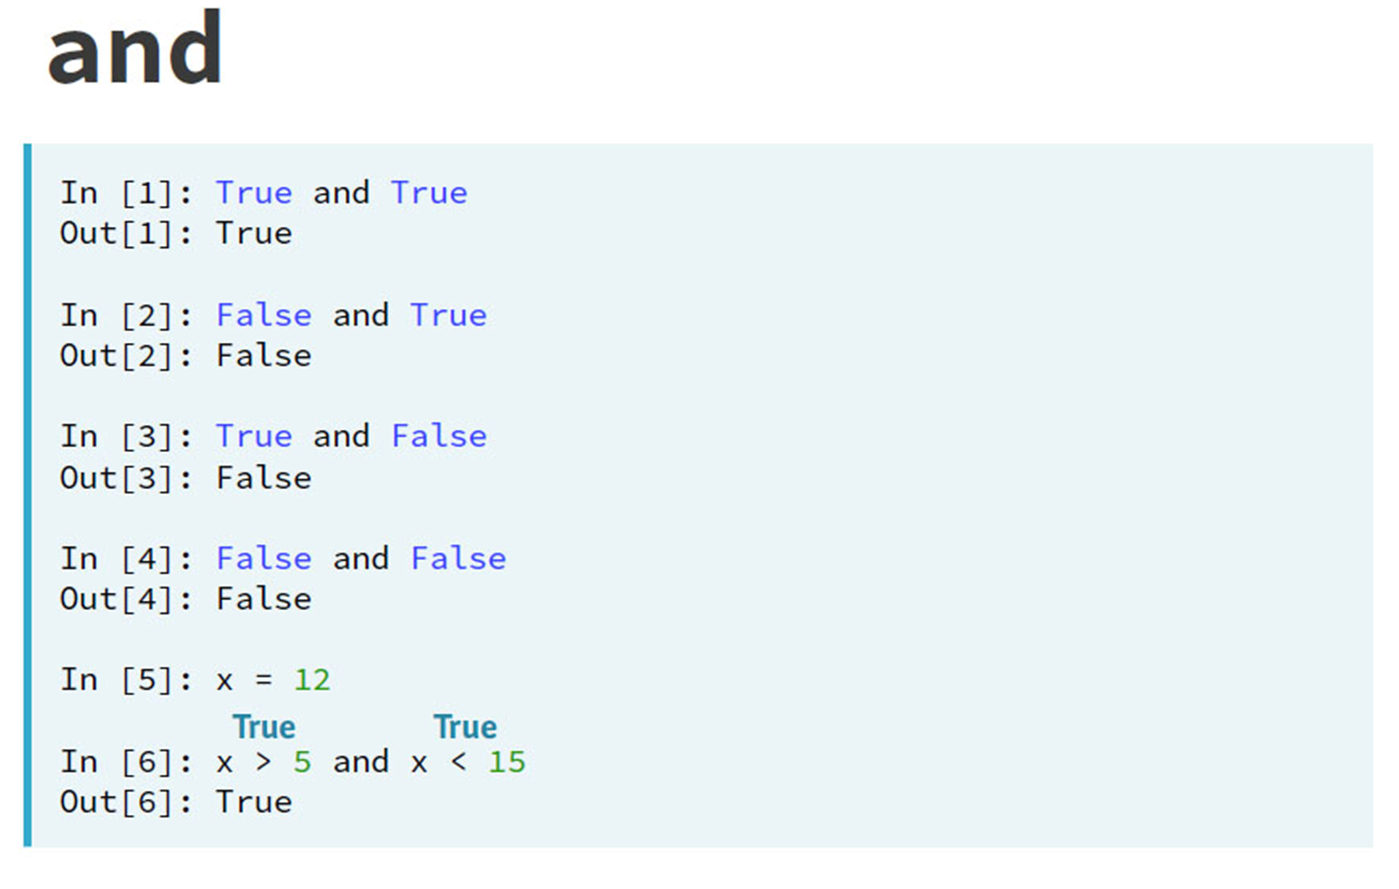

Slide 34
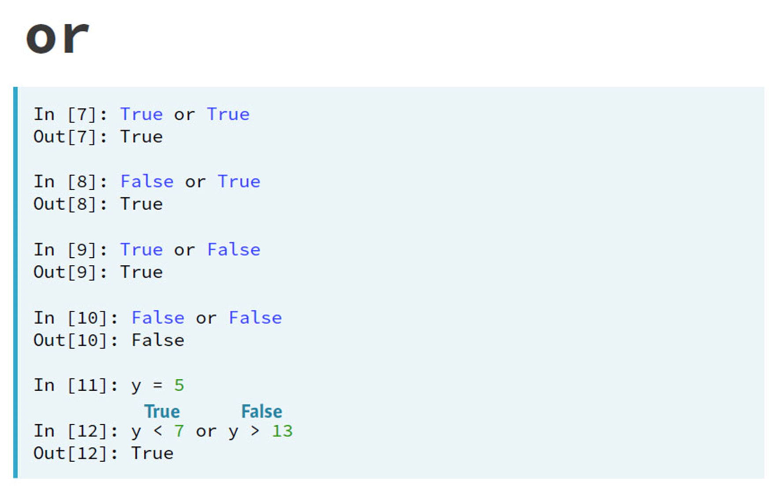

Slide 35
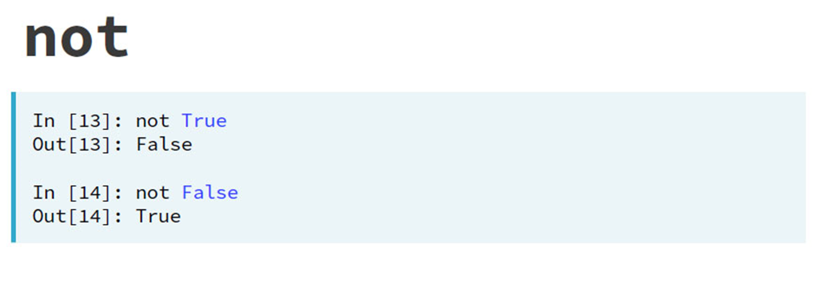

Slide 36
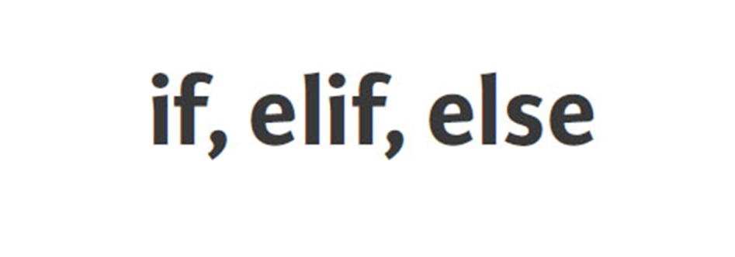

Slide 37
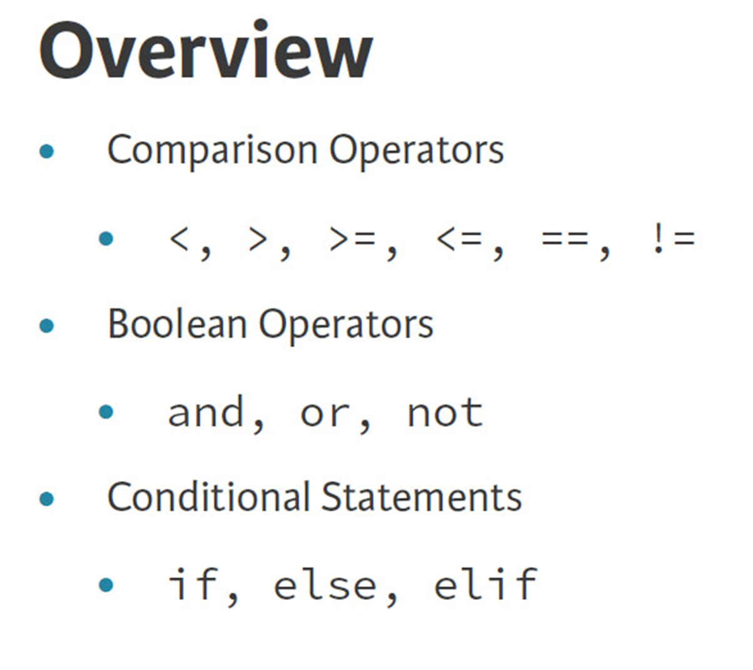

Slide 38
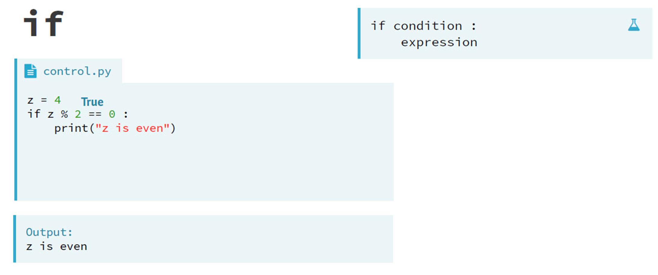

Slide 39
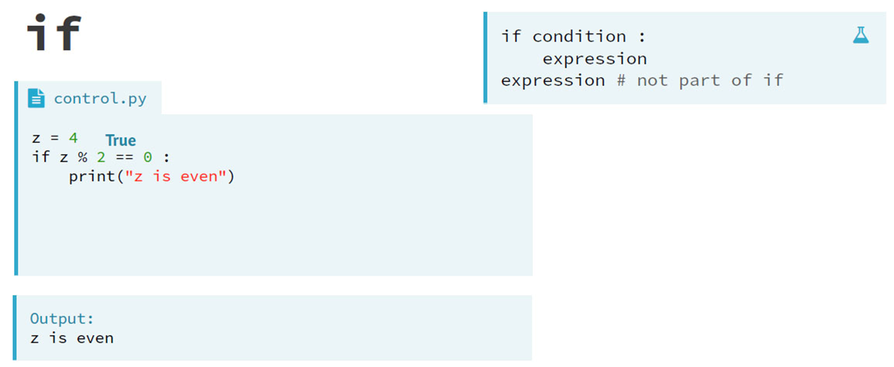

Slide 40
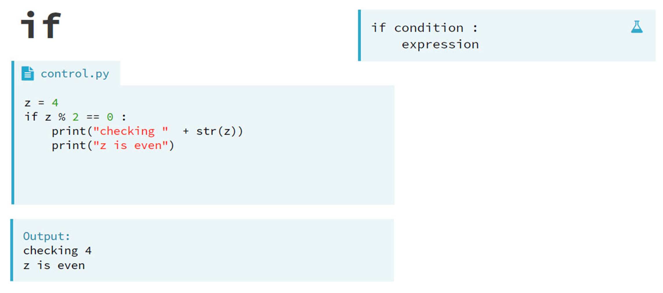

Slide 41
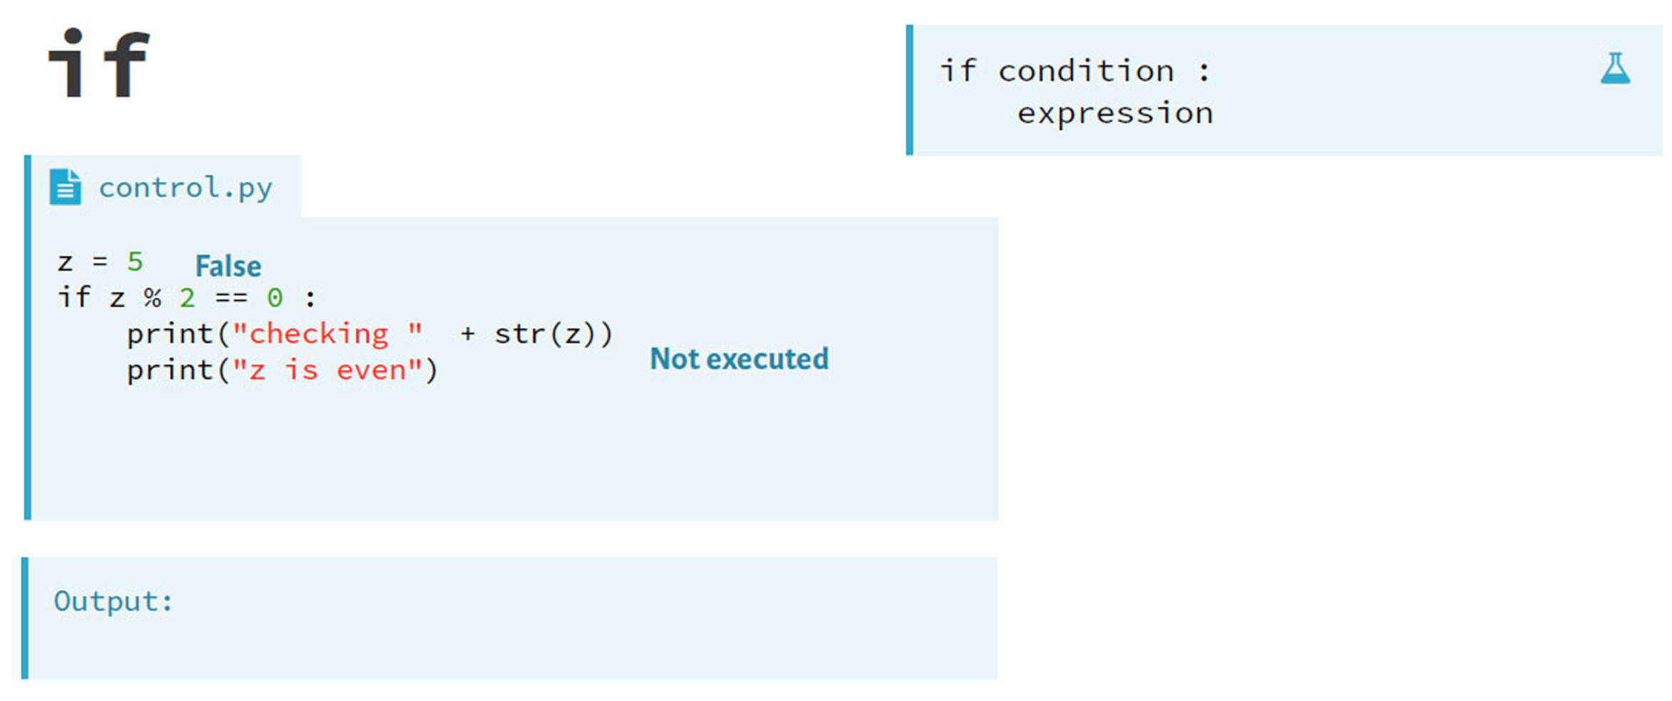

Slide 42
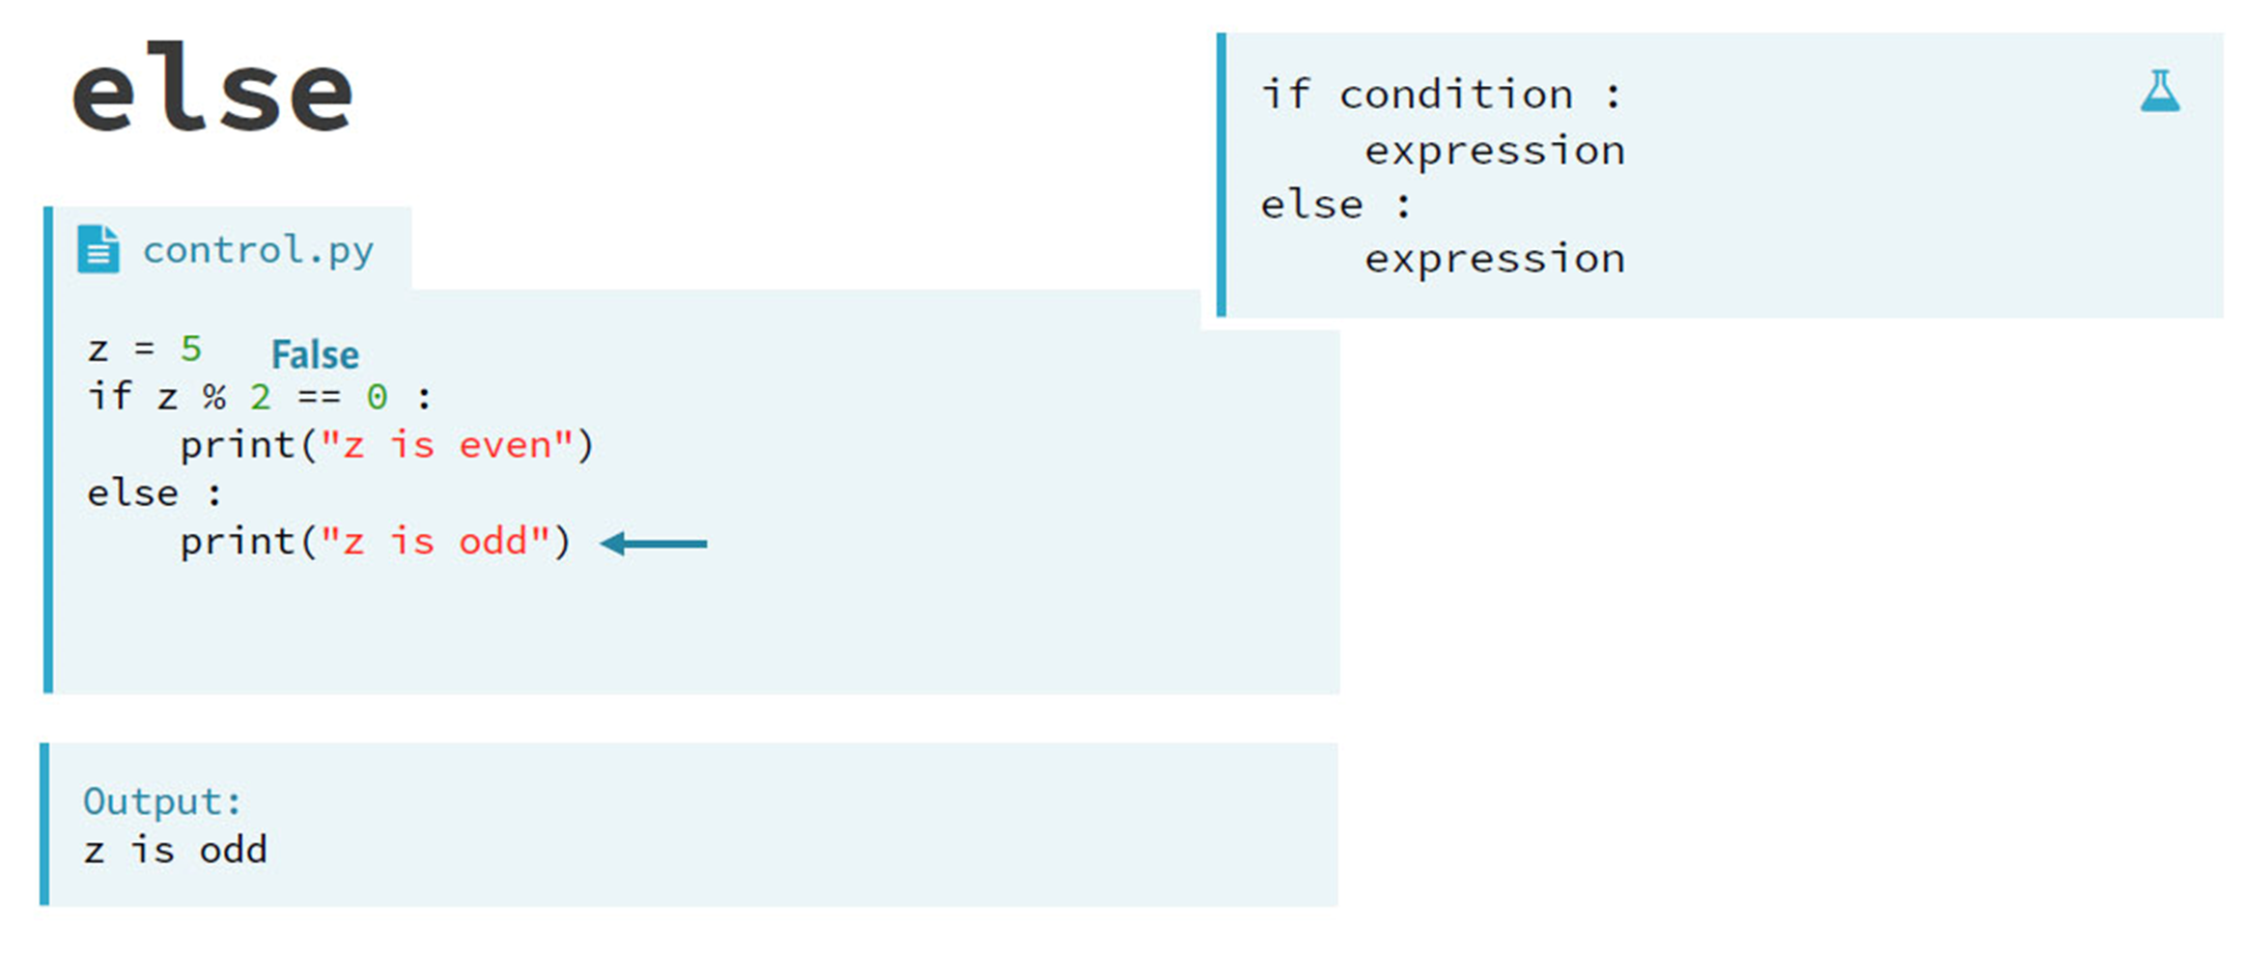

Slide 43
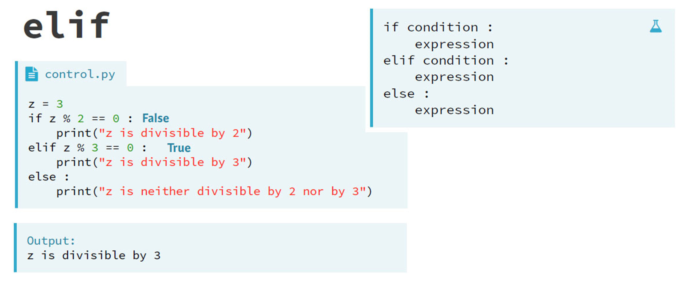

Slide 44
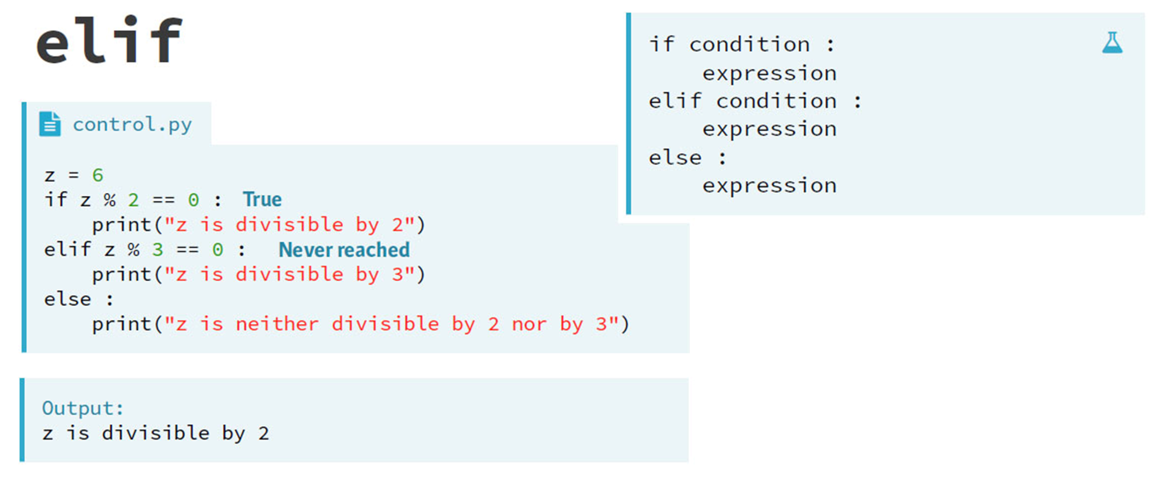

Slide 45
Python Loops

Slide 46
Python has two loop commands:
while loops
for loops

Slide 47
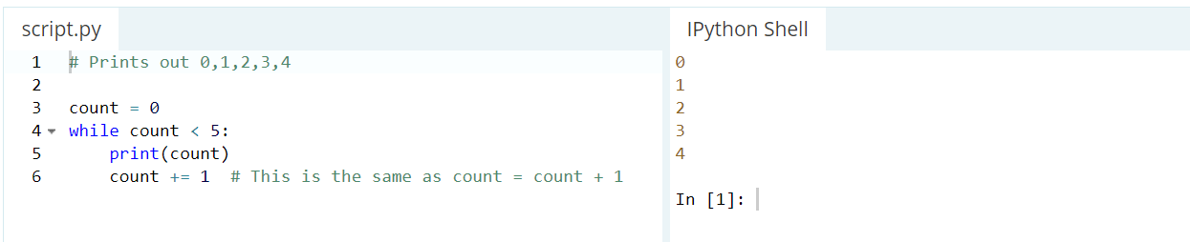
With the while loop we can execute a set of statements as long as a condition is true.

Slide 48
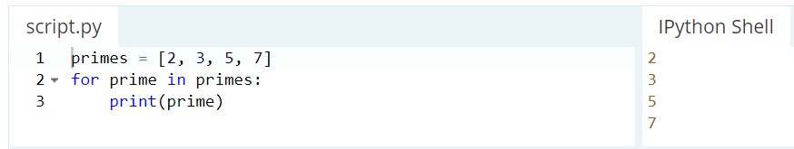
The For loop
For loops iterate over a given sequence.

Slide 49
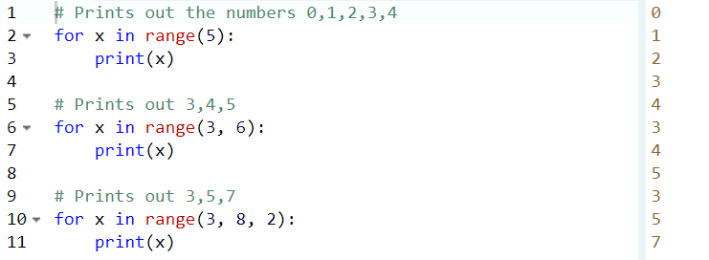
For loops can iterate over a sequence of numbers using the "range" and "xrange" functions. The difference between range and xrange is that the range function returns a new list with numbers of that specified range, whereas xrange returns an iterator, which is more efficient. (Python 3 uses the range function, which acts like xrange). Note that the range function is zero based.

Slide 50
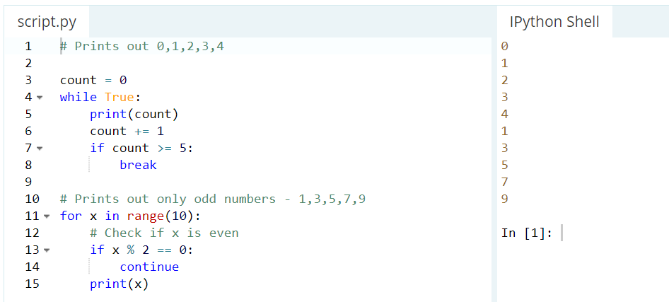
Break and Continue statements
break is used to exit a for loop or a while loop, whereas continue is used to skip the current block, and return to the "for" or "while" statement.

Slide 51
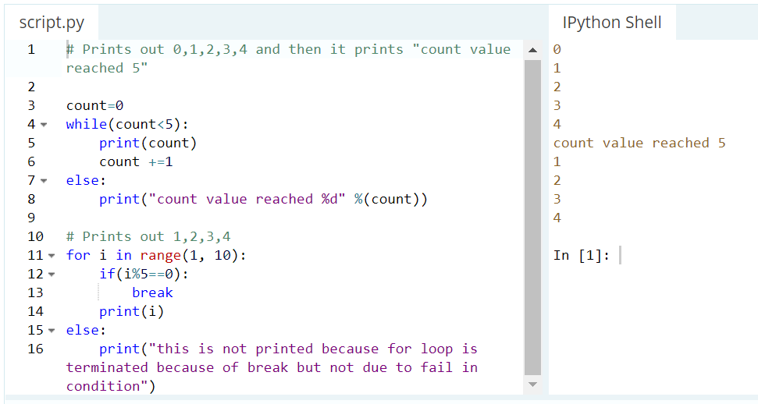
Using else clause for loops
unlike languages like C,C++.. we can use else for loops. When the loop condition of "for" or "while" statement fails then code part in "else" is executed. If break statement is executed inside for loop then the "else" part is skipped.
Note that "else" part is executed even if there is a continue statement.

Slide 52


